Slide 1








WORLD HAPPINESS REPORT
Appraisals of the state of global happiness

Slide 2

Objective
To examine the relationship and influence of the six variables used in the yearly WHRs to the subjective well-being rating.
Project Brief
Data
Skills and Tools
An open-sourced data set from 2015 to 2019 provided by World Happiness Reports
Python (Pandas, NumPy, Matplotlib, Plotly, Scipy, Seaborn, Folium, JSON, sklearn, quandl, statsmodel)
Anaconda
Graphic Visualization with Python
Supervised Machine Learning: Regression
Unsupervised Machine Learning: Clustering
Storytelling in Tableau
GitHub - Python Analysis
Constraints: Participating countries varied from year to year.
The respondents can have a bias of emotions at that moment in time of participation in the Gallup Poll survey.
Files link
WORLD HAPPINESS REPORT

Slide 3
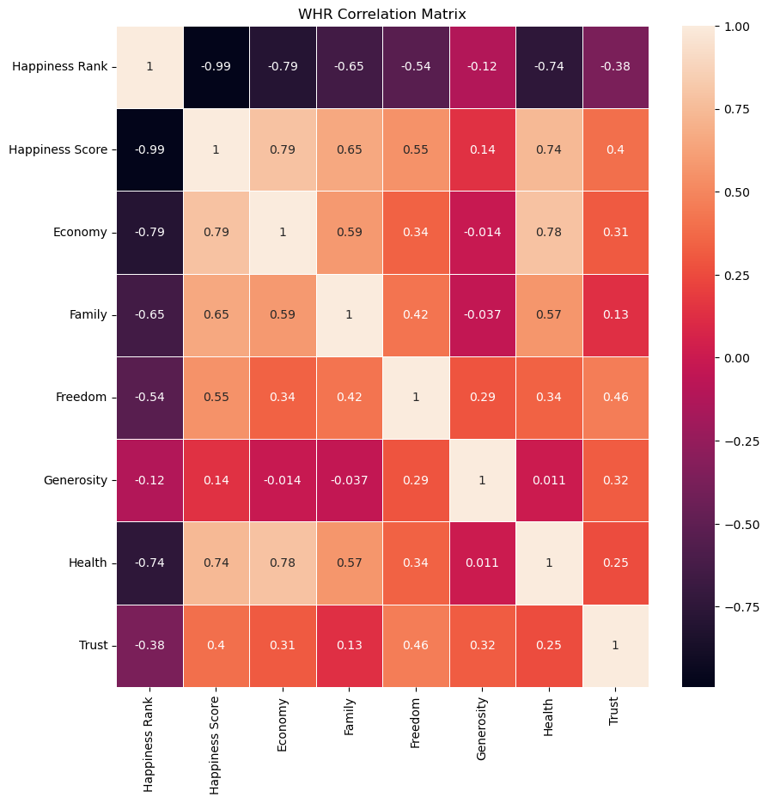
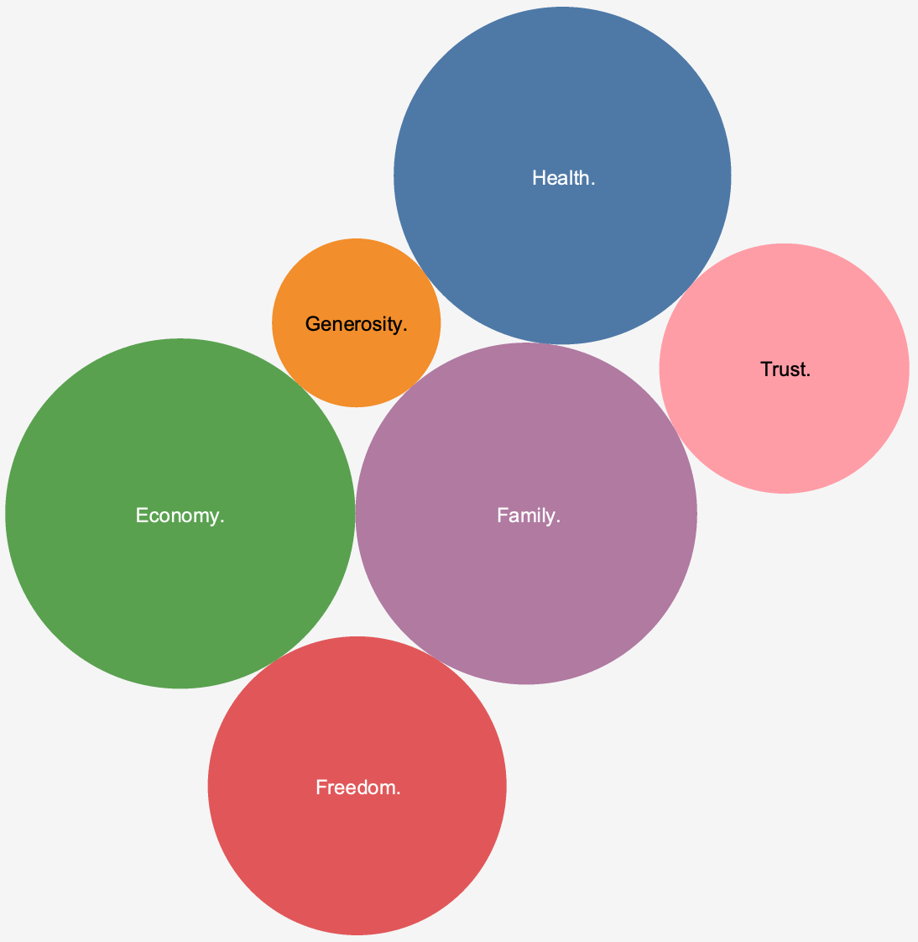
Defining the variables:
Economy - Financial performance of country, in terms of GDP per capita.
Health - Quality and access to healthcare impacting life expectancy.
Family - Support of someone in times of need.
Freedom - The feeling of liberty living in the country.
Generosity – The giving nature of people.
Trust – Confidence in the government
ANALYSIS
Correlation analysis indicates a statistical relationship between several variables to the Happiness Score.
Economy, Family, Freedom, Health
WORLD HAPPINESS REPORT

Slide 4
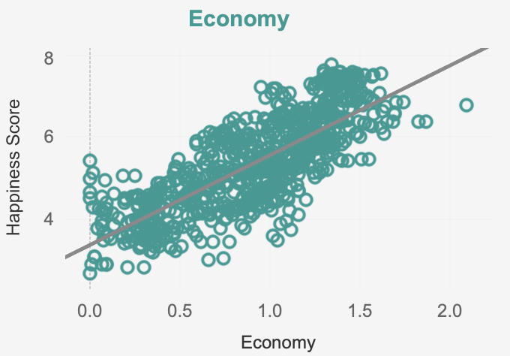
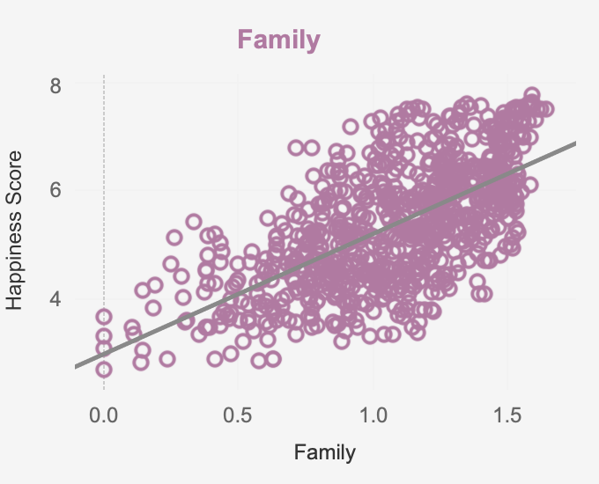
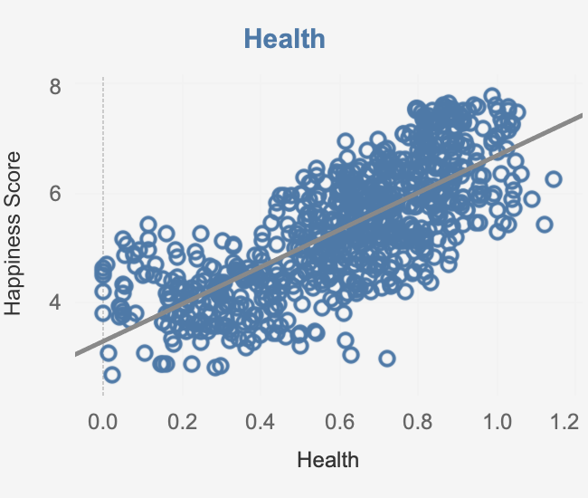
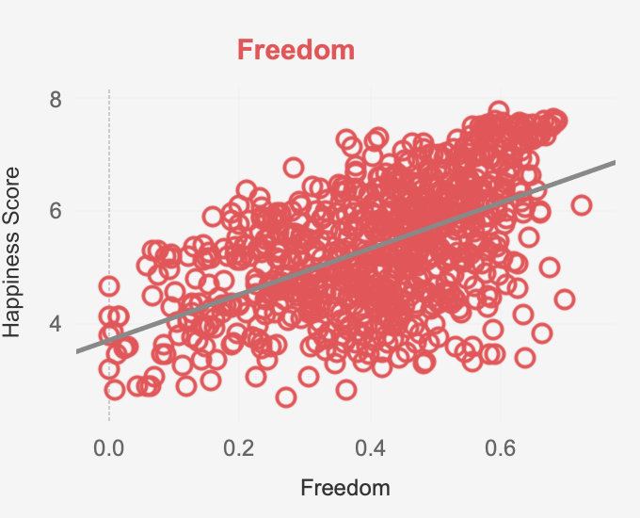
- People residing in countries with a higher GDP are happier than the countries with lesser GDP's.
ANALYSIS
Executing a linear regression model on the four leading variables, a modest positive association was observed, respectively. Economy displayed the strongest relationship while Freedom presented to be the least.
Economy – 62%
Health – 55%
Family – 42%
Freedom – 30%
Hypotheses were formed:
- Countries located within the Western world have an elevated Happiness Ranking to countries in other regions.
WORLD HAPPINESS REPORT

Slide 5
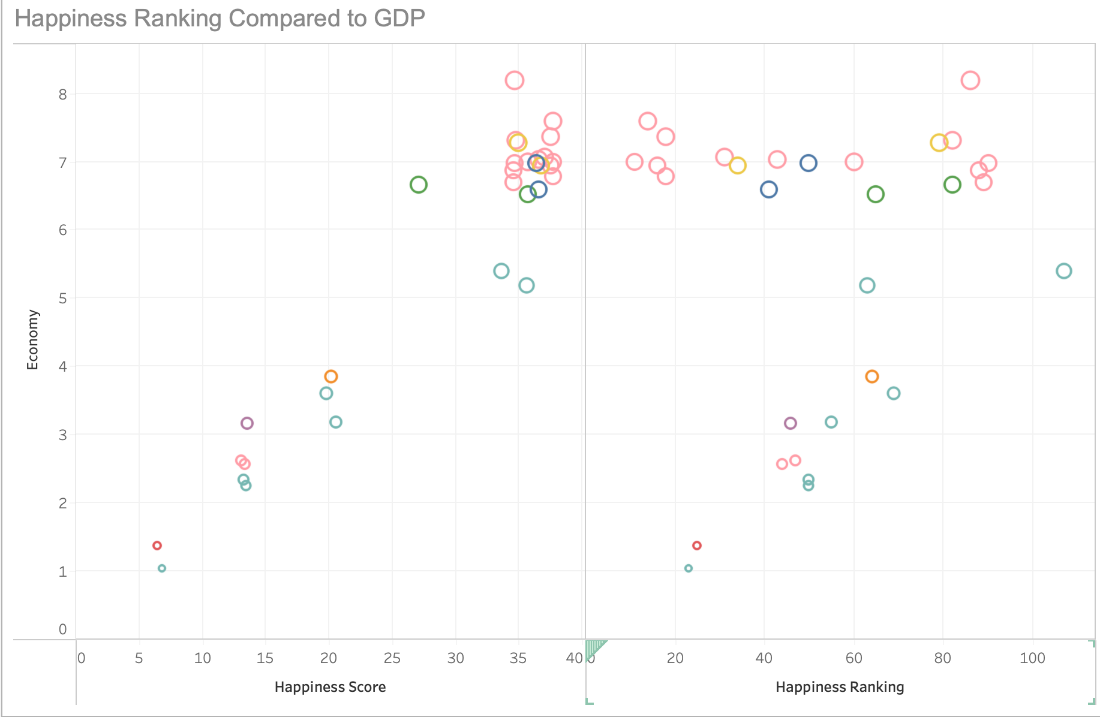
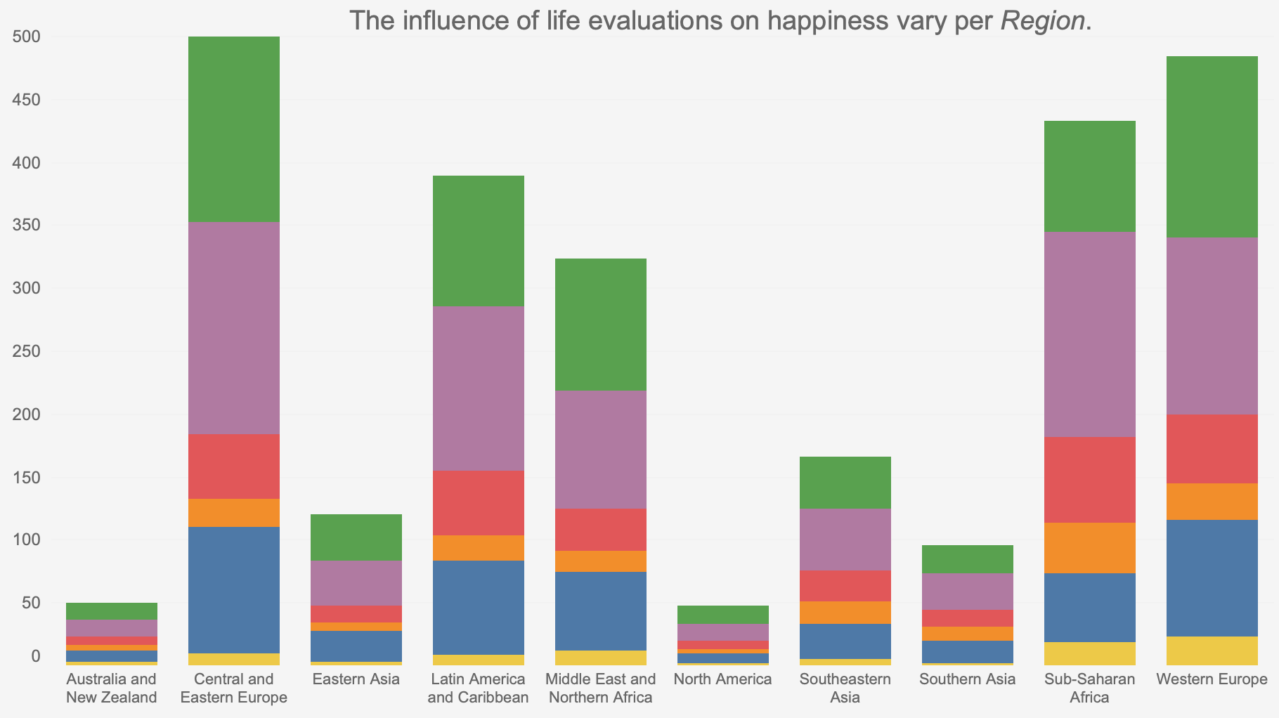
People living in countries with a higher GDP do not trend to have a superior Happiness Ranking over countries with a lower GDP. As observed, there is a relationship with greater Economy to the Happiness Score, although other variables also factor in.
ANALYSIS
Family and economic wealth play a chief role around the
world, while reliance in one's government has minimal
impact on the Happiness Score.
Annually, Western Europe is in the top standings for
the Happiness Ranking. Most notable is the Nordic
region along with Switzerland.
WORLD HAPPINESS REPORT

Slide 6

Recommendations
Happiness is an emotional state that is derived from a multitude of factors. Not just one plays a role, although some have a greater impact than others.
There were three notable influencers to the Happiness Score, economy of one’s country, the support of family, and healthy life expectancy. Over the years these continue to weigh-in significantly.
Countries with higher GDP do not rank higher than others
The Western European region has the happiest inhabitants world-wide.
The Nordic region has consistently the top-ranking countries in the World Happiness Report.
The top four countries in the Happiness Ranking collectively year-over-year are Denmark, Norway, Iceland, Finland.
The lowest four countries in the Happiness Ranking collectively year-over-year are Burundi, Suria, Rwanda, and Afghanistan.

Slide 7




Thank you

